Slide 1
Link Error Detection and Failure Recovery in Software Defined Networks
Project Guide Dr. V.Mary Anita Rajam
Team2.G14 (members)
SWETHA V.S.(2012103078)
THILLAIRAJA S.T.S.(2012103611)
SUNIL N.K. (2012103602)

Slide 2
PROBLEM STATEMENT
Links are the cardinal feature of any communication network and so preserving those link is our core purpose.
Providing a reliable network without any faults.
Detecting and recovery of the link is the prime objective. But maintaining the link is a difficult task.
By coordinating among SDN switches, we can explore multiple backup paths for the failure recovery

Slide 3
LITERATURE SURVEY
S NO | REFERENCE PAPERS | PUBLICATIONS AND YEAR | EXPLANATION
1 | Detour Planning for Fast and Reliable Failure Recovery in SDN with OpenState | Design of Reliable Communication Networks (DRCN), 2015 11th International Conference on 24-27 March 2015 | Provides a secure and a reliable path in case of link failure. Ensures zero packet loss in this mechanism. Routing technique used here is MPLS.
2 | Openflow Path Fast Failover Fast Convergence Mechanism | Network Research Proceedings of the Asia-Pacific Advanced Network 2014 v. 38, p. 23-28 | The paper deals with a fast and efficient failover mechanism for redirecting traffic to more optimal backup path when there is a link failure or congestion problem in SDN. It also proposes a local pre-calculated path dataset mechanism in OpenFlow controller to allow fast network convergence.
3 | A Europe-wide demonstration of fast network resto- ration with OpenFlow | IEICE Commun. Express, vol. 3, no. 9, pp. 275–280, 2014. | Segment protection is the key feature used to reroute the data in the secondary route which may or may not be the best or optimal path. Independent Transient Plane (IPL) is designed in this paper which reduces the path complexity and maintains the security of the data.
4 | OpenFlow-Based Segment Protection in Ethernet Networks | IEEE/OSA Journal of Vol 5 ,No 1, September 2013 | This paper is based on providing a segment based rerouting algorithm for efficient transfer of messages in case of link failures.

Slide 4
S NO | REFERENCE PAPERS | PUBLICATIONS AND YEAR | EXPLANATION
5 | Orion: A Hybrid Hierarchical Control Plane of Software-Defined Networking for Large-Scale Networks | 2014 IEEE 22nd International Conference on Network Protocols. | This paper explains the Orion architecture which overcomes the issues of the flat control plane structure and the centralized abstracted hierarchical structure of the control plane.
6 | Fast Recovery in Software-Defined Networks | IEEE Software Defined Networks (EWSDN), 2014 Third European Workshop on 1-3 Sept. 2014 | This paper implements a failover scheme with per-link Bidirectional Forwarding Detection sessions and preconfigured primary and secondary paths computed by an OpenFlow controller. Uses two steps- switch-initiated recovery and then controller calculating the optimal paths.
7 | Fault-Tolerant OpenFlow-based Software Switch Architecture with LINC Switches for a Reliable Network Data Exchange | Research and Educational Experiment Workshop (GREE), 2014 Third GENI 19-20 March 2014 | This paper describes the usage of the Erlang Distributed System to replace the hardware switches with open flow software switches to better the fault-tolerance system.

Slide 5
ISSUES IDENTIFIED FROM THE SURVEY
In case of link failures, packet loss will be high.
Also, the contents of the lost packets cannot be retrieved.
Moreover, the re-routing schemes that are currently in use is ineffective. It takes longer time delays to calculate the alternate path.
Thus the process of detecting the link failure in a network and providing a secure path for the packets should be done through early detection and efficient re routing.

Slide 6
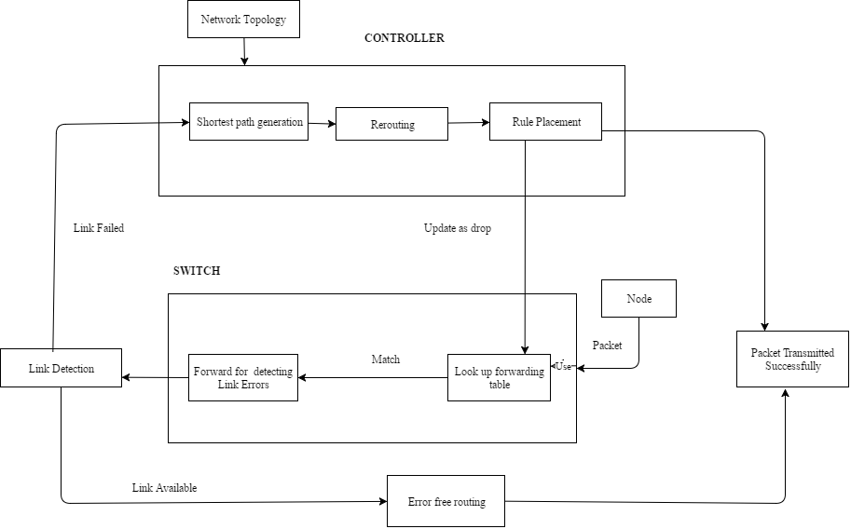
ARCHITECTURE DIAGRAM

Slide 7
MODULES SPLIT UP:
Link Detection Module
Path Calculation Module
Recovery Module
Rule-Placement module

Slide 8
LINK DETECTION MODULE:
Link between nodes is considered to be the framework for any network and so preserving the link is cardinal.
If the network link is error free ,it reroutes and finally transmits the packets without any loss.
If a link failure is detected, the nodes between the failed link is identified. After the detection of link failure, input is then passed to the recovery module, and the open flow protocol intimates the SDN controller.

Slide 9
PSEUDO CODE:
for each switch in a network
sending & receiving ping messages to nearby switches
IF (link failure detected)
identify the failed link between switches
link array[] = store the failed link
initialize link flag bit =1
IF (packet loss > buffer limit in switches)
stop the packet transmission from the source.
pass the packet flow to recovery module
modify the routing table and initialize the flag bit =1.
intimate the SDN Controller.
ELSE
re routing the packets without loss.

Slide 10
PATH CALCULATION MODULE
The module helps in calculating the optimal path between two hosts. The path is calculated with the help of shortest path algorithm and ports calculation algorithm.
Inputs to the module are two variables, src and dest. The source host is stored in the variable src and the destination host is stored in the variable dest.
THE SHORTEST PATH ALGORITHM
The variable graph contains the network topology defined by the network administrator. The variable src is stored in the variable start and the variable dest is stored in the variable end. The output is the shortest path between the start and the end nodes. The output is stored in the variable tmp-path.

Slide 11
PSEUDO CODE:
def spath(graph,start,end,path=[]):
temp-path=[start]
add tmp-path to queue
while q is not empty
dequeue q to tmp-path
last-node=tmp-path[len(tmp-path)-1]
print tmp-path
if last-node == end
tm-path is a valid path
for link node in graph[last -node]
if link node not in tmp-path
newpath = tmp-path+ link-node
q.enqueue(new path)
return tmp-path

Slide 12
RECOVERY MODULE
Storing of dropped packets in compression state.
Handling the failed link using the alternate back path (the packets which are not left from the source).
Stored packets are sent using fast rerouting technique.
Packets that are not left from the source are rerouted in pre-calculated alternate path.
Packets that are transmitted before the detected failed link are stored in the switch in the compressed state. The stored packets are then decompressed and fast rerouted to the destined node.
SDN controller controls all the rerouting paths using Dijkstra’s algorithm.

Slide 13
PSEUDO CODE:
IF (link flag bit is set)
Packets which haven’t started from the source are need to be stopped.
Re route the packets from the source in alternated precalculated path.
IF (flag bit is set)
Packets which had started from source are made to stored in a switch in a compressed state before the failed link which is stored in link array[].
Stored switch intimates SDN Controller using OpenFlow protocol.
SDN Controller decompresses the packets
Finding the next alternate shortest path is done by using Dijkstra’s Algorithm

Slide 14
RULE PLACEMENT MODULE:
The rule placement module avoids overloading of switches with rules. A variable n helps in keeping count of the number of rules in the switch. Subprocess call function helps in implementing python commands.
The rules in every switch is written to a file called cover.
If the value exceeds the threshold value 8, the rules in the switch are flushed and new rules are added.

Slide 15
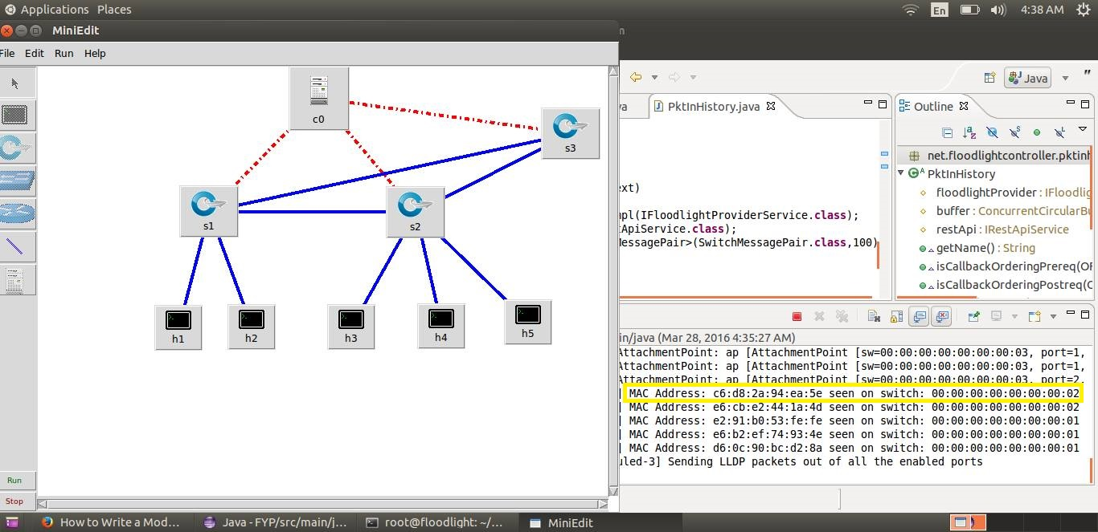
OUTPUT SCREENSHOTS

Slide 16
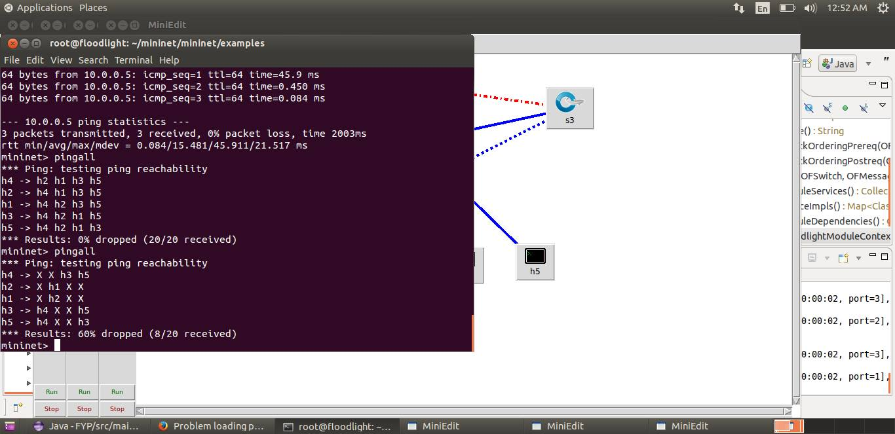
OUTPUT SCREENSHOTS

Slide 17
METRICS FOR EVALUATION:
Assessment of delay of the links
Average time delay vs packets sent(link up and link down)
Time delay for first packet
Time delay vs 1st packet
Time delays for each other packet
Time delay vs packet number

Slide 18
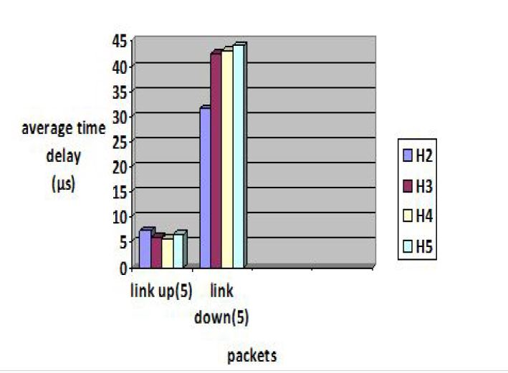
GRAPHS

Slide 19
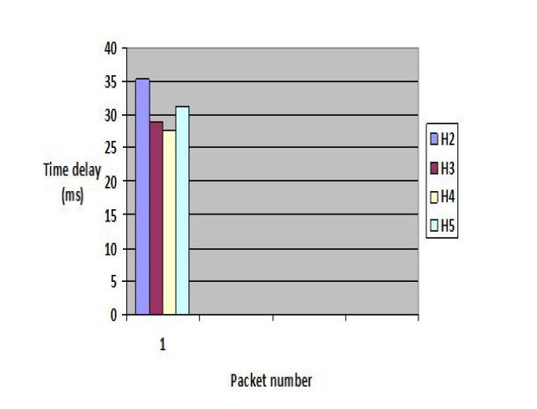
GRAPHS

Slide 20
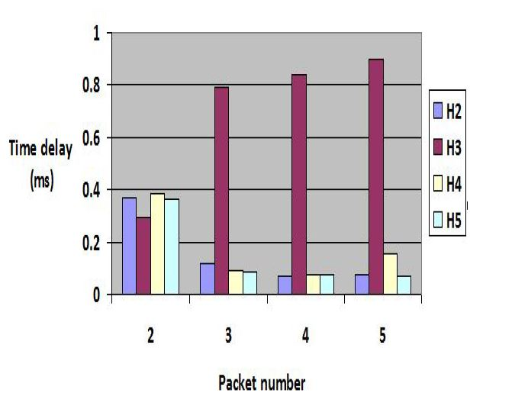
GRAPHS

Slide 21
REFERENCES
[1] Alessandro Q.T. Nguyen Antonio Capone, Carmelo Cascone and Brunilde Sans, “Detour planning for fast and reliable failure recovery in sdn with openstate, design of reliable communication networks (drcn)”, 11th International Conference in Communication
Networks, pp. 14–18, March 2015.
[2] W. Braun and M. Menth, “Scalable resilience for software-defined networking using loop-free alternates with loop detection, network softwarization (netsoft)”, 1st IEEE Conference in Loop free alternates and Loop detection, vol. 9, pp. 78–81, September 2015.
[3] M.Caldwell Caesar and J.van der Merwe, “Efficient routing for traffic offloading in software-defined network”, International Workshop on Software Defined Networks for a New Generation of Applications and Services, pp. 13–17, September 2014.

Slide 22
[4] F. Paolucci Giorgetti and P. Castoldi, “Openflow-based segment
protection in ethernet networks”, IEEE Journal of Optical Communications
and Networking, vol. 5, num. 1, pp. 234–245, September
2013.
[5] Z. Chen J.Wu J. Bi, K. Gao and B. Hao, “Robust fault-recovery in software-defined networks”, IEEE 16th International Conference on Network Protocols., vol. 3, pp. 234–238, September 2014.
[6] Hyojoon Kim and Nick Feamster, “Europe-wide demonstration of fast network resto-ration with openflow”, IEEE 22nd International Conference on Network Protocols., vol. 3, pp. 275–280, March 2014.

Slide 23
CONCLUSION
Thus in this project, a network is simulated on which Link Failure is detected and packet loss is handled. The shortest path is calculated from multiple paths present and thus an alternate path is chosen, if any link along the path calculated goes down.
The packets are stored in switch to overcome the reduction in packet dropping between the links. The rules in a switch are flushed before installing new rules, if the count exceeds the threshold decided.
Thus the link failures in SDN is handled in an efficient manner by the technique of storing in switch buffers. Also , the packets are not lost and the network is reliable because the link failure is handled efficiently

